Slide 1
Smart study planner
CAPSTONE PROJECT
Presented By:
Abhinav Pandey

Slide 2
OUTLINE
Problem Statement (Should not include solution)
System Development Approach (Technology Used)
Algorithm & Deployment (Step by Step Procedure)
Result
Conclusion
Future Scope(Optional)
References

Slide 3
Problem Statement
Students face significant challenges in academic organization and productivity:
Scheduling Difficulties: Students struggle to organize study schedules effectively across
multiple subjects
Task Tracking Issues: Lack of systematic approach to track academic assignments and
deadlines
Priority Management: Difficulty in prioritizing tasks based on urgency and importance levels
Progress Visibility: No clear visual representation of study progress and time allocation
Productivity Tools: Limited access to integrated tools for focused study session management
Comprehensive Solution Need: Requirement for a unified platform combining task
management with productivity features

Slide 4
System Approach
Frontend Technologies:
HTML – Structure of the webpage
CSS – Styling and responsive layouts
JavaScript – Dynamic interactivity (cart, filtering, total calculation)
Design Approach:
Clean and user-friendly interface
Mobile-responsive design
Modular separation of HTML, CSS, and JS files

Slide 5
Algorithm
Application Initialization:
Load sample data and configure event listeners
Initialize theme preferences and user settings
2. Task Management System
Implement CRUD operations with data validation
Create task filtering and sorting algorithms
3. Calendar Integration
Generate dynamic calendar views with task visualization
Calculate date-based task distributions
4. Productivity Timer
Build Pomodoro timer with session state management
Track study sessions and break intervals
5. User Interface .
Create responsive layouts with CSS Grid and Flexbox
6. Progress Tracking
Implement theme switching with CSS variable manipulation
Calculate completion percentages and statistics

Slide 6
Deployment
Deployment:
The project is deployed using GitHub Pages, leveraging GitHub's hosting capabilities to serve the application directly from the repository.

Slide 7
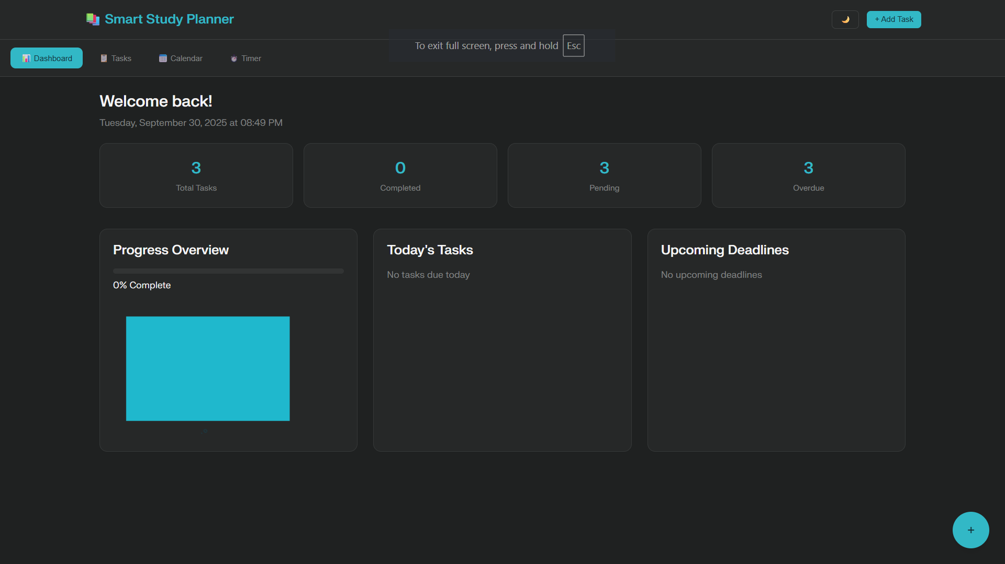
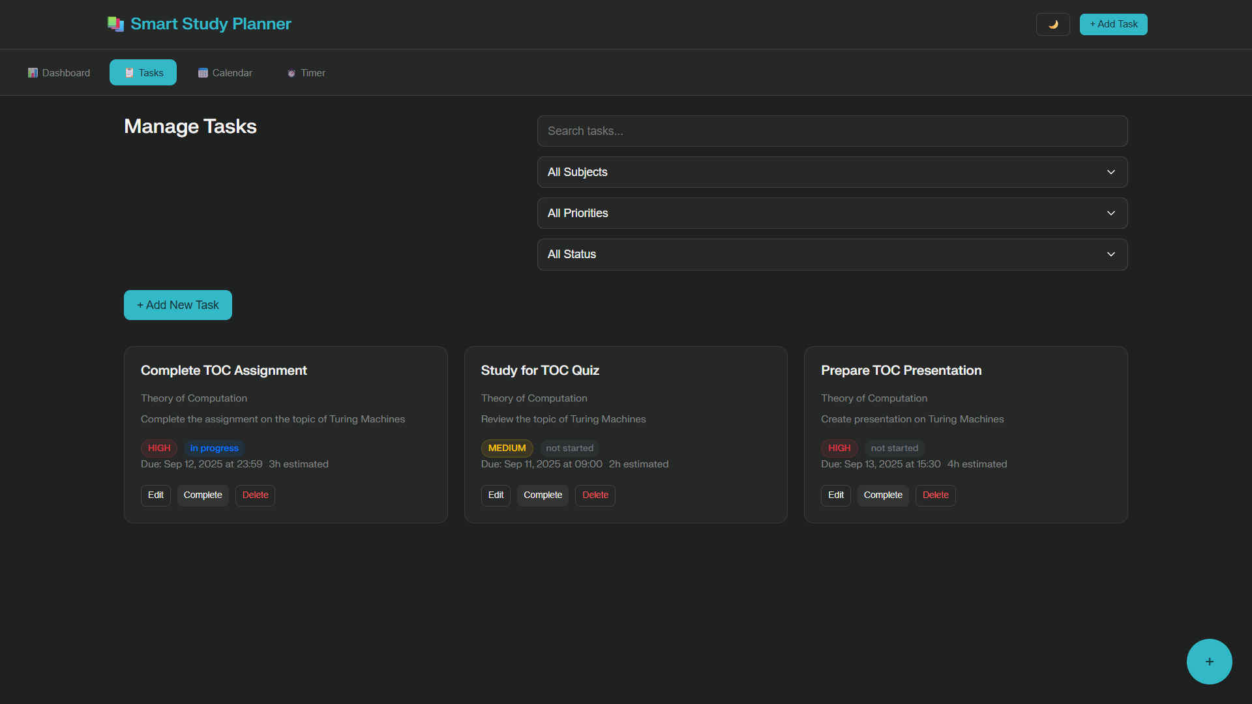
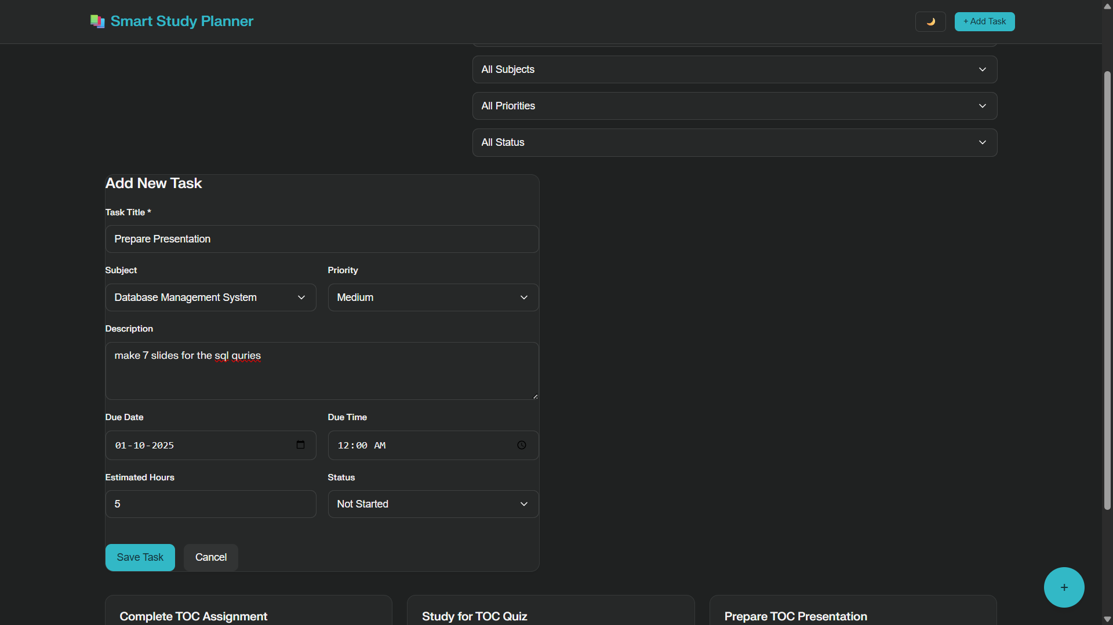
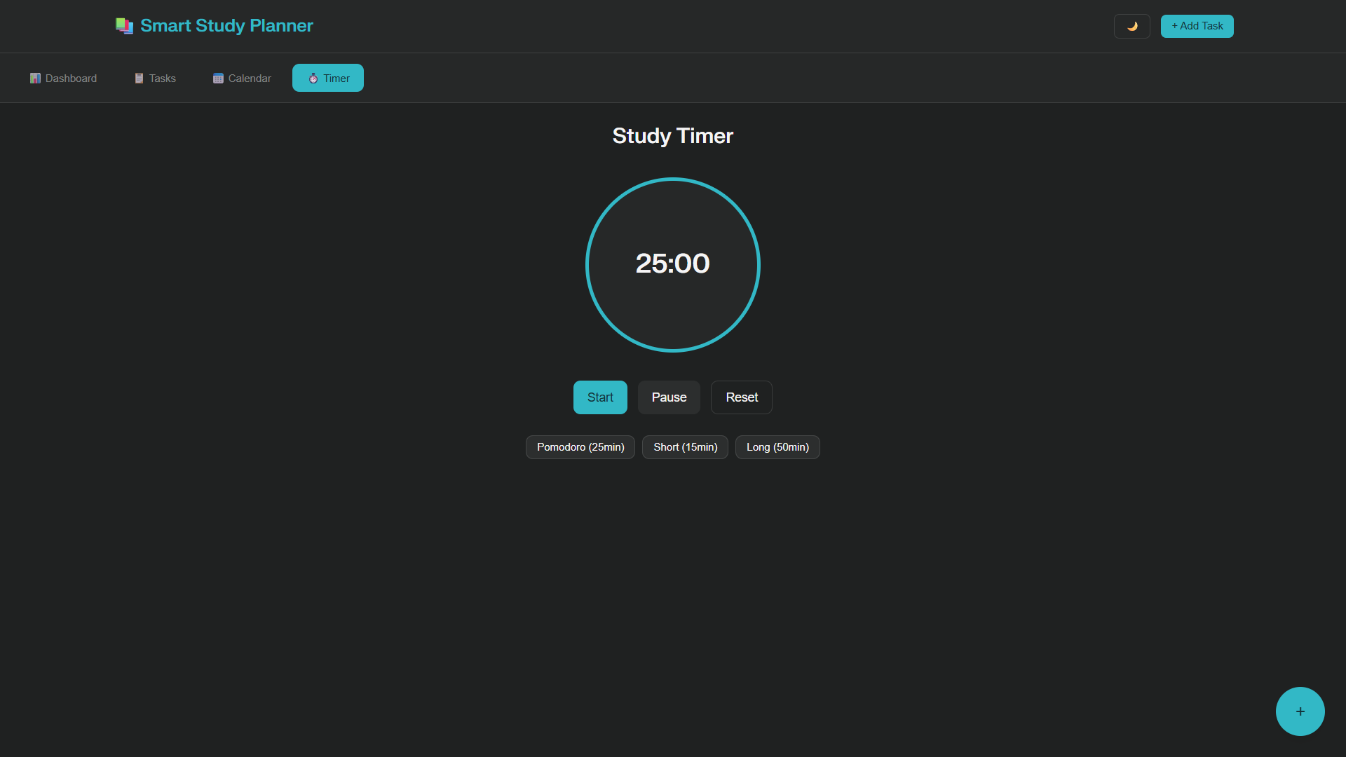
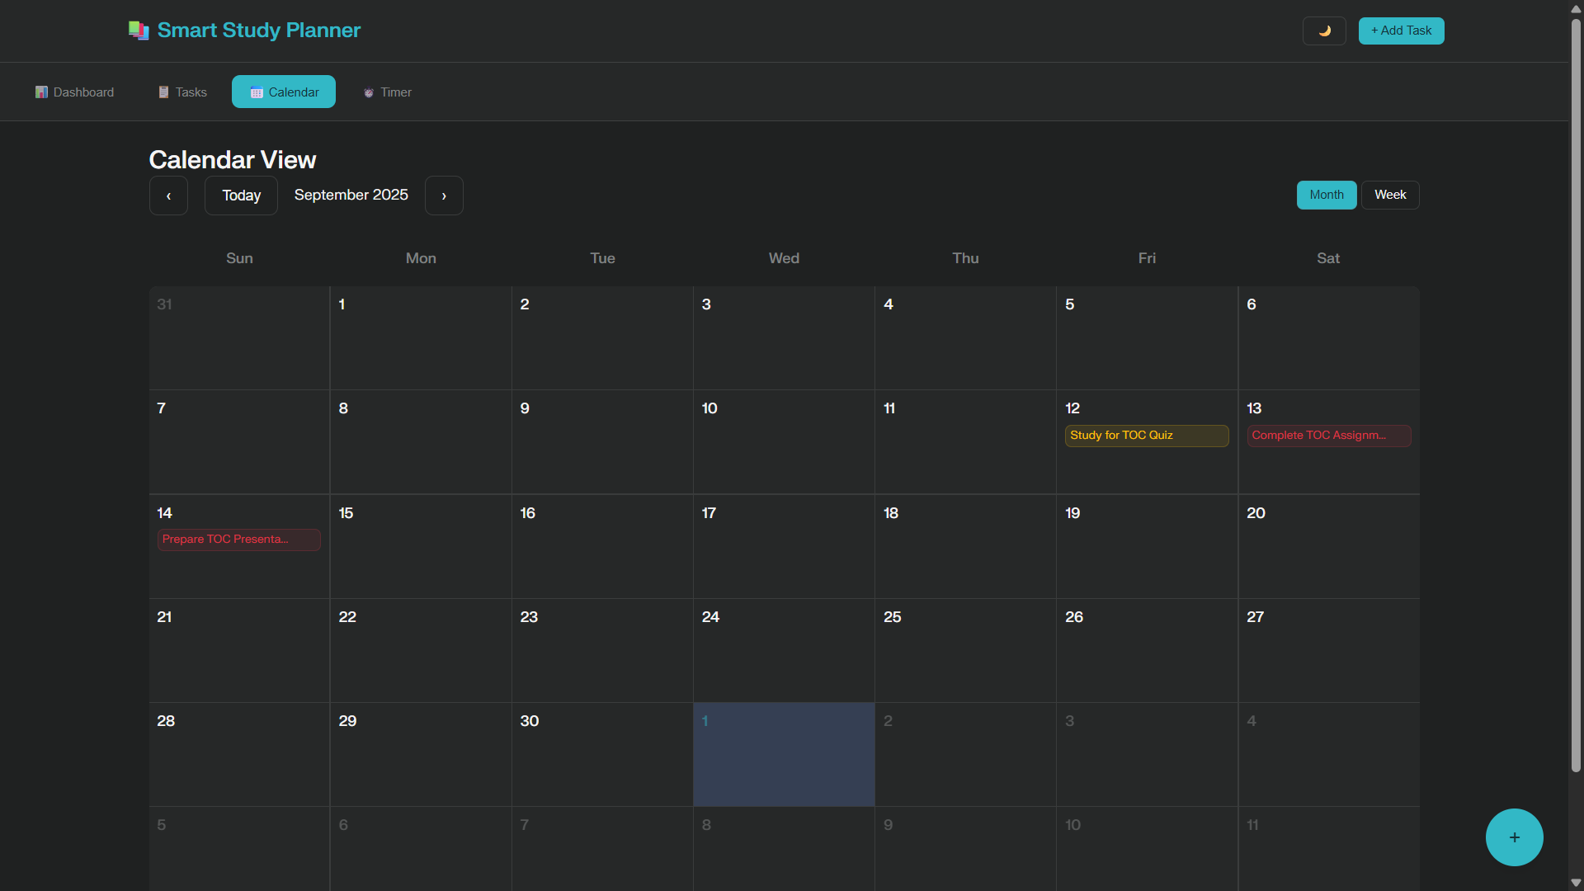
Result (desktop version)

Slide 8
GITHUB AND DEPLOYMNET LINK
Attach your Github Link : https://github.com/Abhinav12004/Smart-Study-Planner
Deployment link: https://github.com/Abhinav12004/Smart-Study-Planner.git

Slide 9
Conclusion
The Smart Study Planner successfully transforms the challenge of academic organization into an intuitive, web based solution.
This project demonstrates the effective use of modern web technologies to create a practical
application that directly addresses student productivity needs.

Slide 10
Future scope
Advanced Features:
Cloud Synchronization: Implement backend services for cross-device data sync
Collaborative Study: Multi-user support for group study sessions and shared tasks
AI-Powered Recommendations: Smart task prioritization based on user patterns
Integration APIs: Connect with popular calendar applications (Google Calendar, Outlook)
Mobile Application: Native iOS and Android apps for enhanced mobile experience
Analytics & Insights
Study Pattern Analysis: Generate detailed reports on study habits and productivity trends
Performance Metrics: Advanced statistics and goal-setting features
Time Tracking: Comprehensive time allocation analysis across subjects
Productivity Insights: Data-driven suggestions for improving study efficiency

Slide 11
References
Mozilla Developer Network (MDN) - HTML5, CSS3, and JavaScript documentation
World Wide Web Consortium (W3C) - Web standards and specifications
IBM skill build web development Fundamentals.
Browser Developer Tools Documentation - Debugging and testing resources

Slide 12
THANK YOU

